Slide 1
Using R for Data Science
Steven Gollmer
Cedarville University
Notes:
Picture from wikipedia - Dice

Slide 2
What is Data Science?
Definition
  Data science, also known as data-driven science, is an interdisciplinary field about scientific methods, processes, and systems to extract knowledge or insights from data in various forms, either structured or unstructured, similar to data mining. (Wikipedia)
“The key word in ‘Data Science’ is not Data, it is Science” (Jeff Leek)
  Analytics, Data Mining, Neural Nets are just tools for managing and exploring “Big Data.”
Are you trying to answer interesting questions?
  The trap is focusing on a collection of techniques or tools.
  The goal is to extract a better understanding of a system.
  These techniques can be used to engineer solutions.
Notes:
https://simplystatistics.org/2013/12/12/the-key-word-in-data-science-is-not-data-it-is-science/

Slide 3
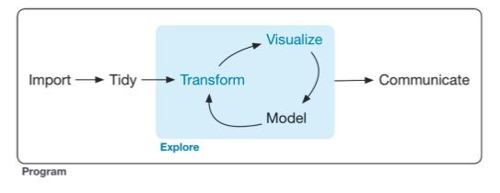
What do data scientists do?
Expectations (Most important skills of data scientists, TEDx talk)
  Answers in days rather than months
  Exploratory analysis and rapid iteration
  Visual representation to enhance insight
  Turn data into actionable insight
R for Data Science (p. 1)
Notes:
TEDx reference from Wikipedia: Data Science, reference 26.
Diagram from R for Data Science by Wickham and Grolemund

Slide 4







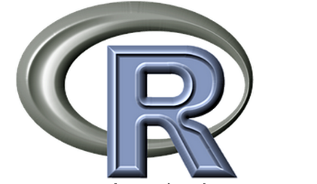



Data Science Tools
Statistical Programs and Platforms
Open Source Programs and Platforms
Visualization Programs

Slide 5
Data Science Seminars
Format
  Meet monthly (Monday evening)
  Presentation of concept and/or tool with examples
  Workshop assisting you to recreate the examples
Background
  Basic understanding of statistics
  Basic programming skills
Possible Topics
  Using R for data science
  Data structures and queries using SQL
  Opinion mining from text based sources
  Geospatial analysis
  Pattern recognition
  Neural Networks
  Data visualization
https://sites.google.com/a/cedarville.edu/data-science/
http://people.cedarville.edu/employee/gollmers/datascience/index.htm

Slide 6
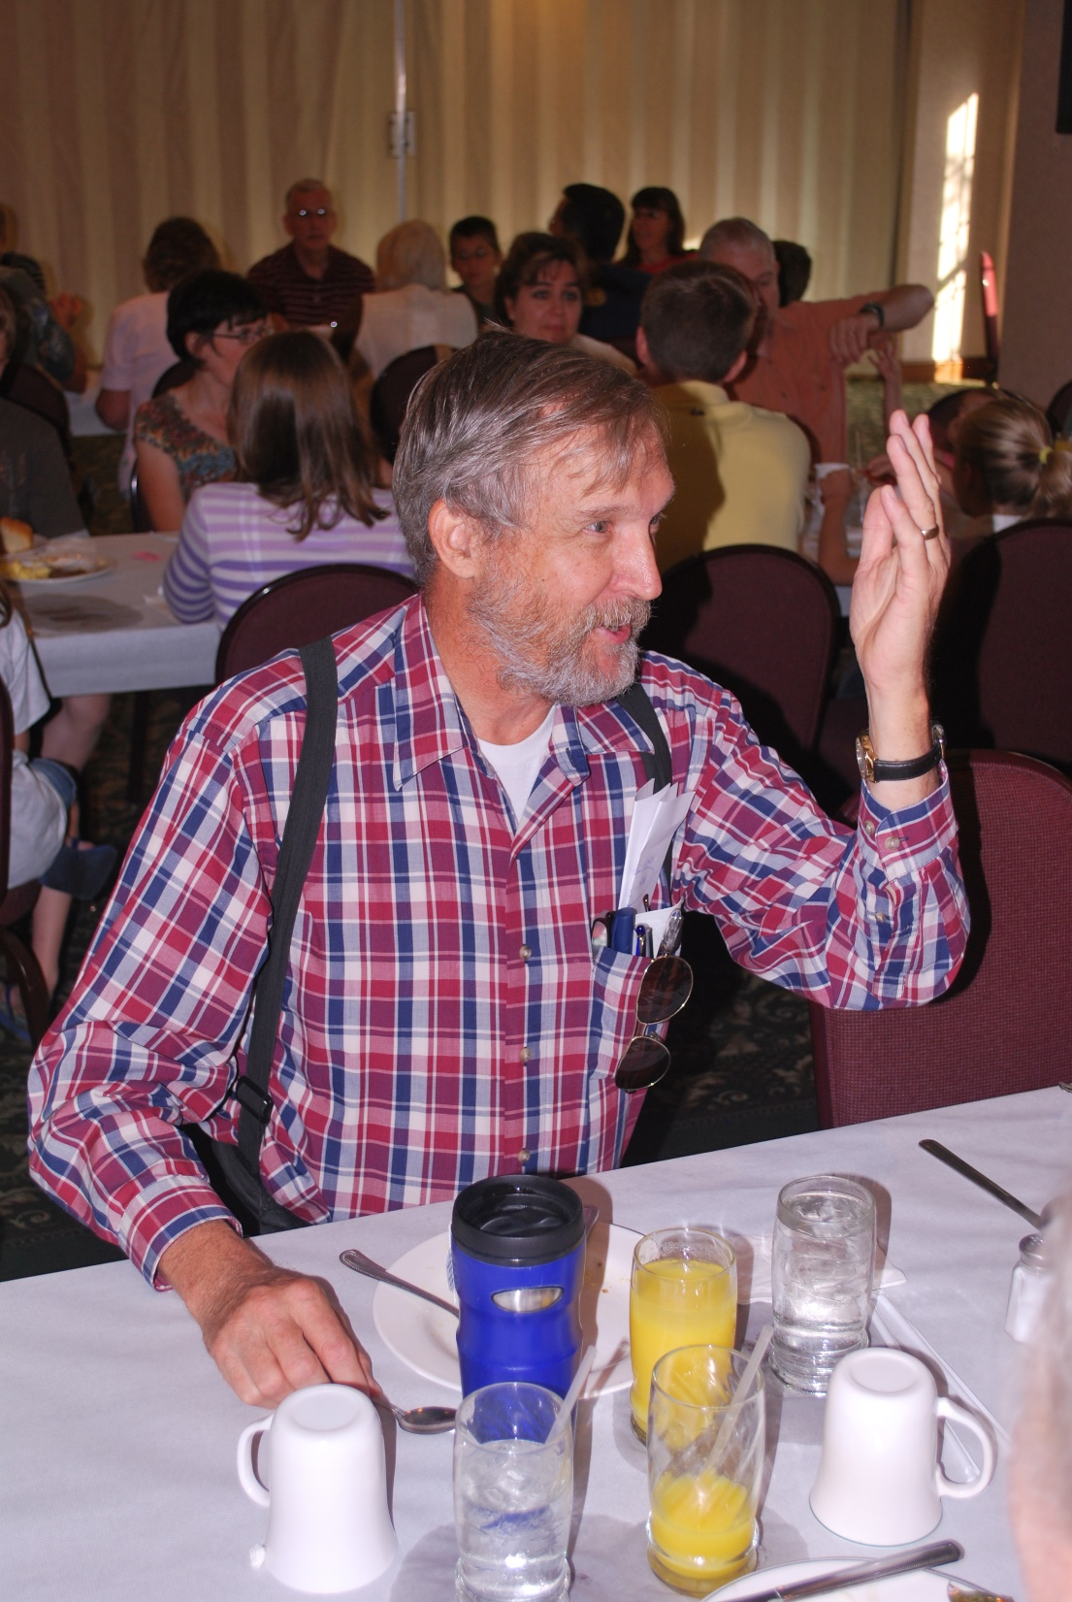
Robert Schumacher
M.S. Operations Research
Retired U.S.A.F. – Lt. Col.
Faculty at CU
  1993-2014
  Mathematics
  Physics
  Computer Science
  Latex and R
Gideon’s International

Slide 7



Tale of Two Languages
“It was the best of times, it was the worst of times…”, Dickens
S

Slide 8
Lisp – LISt Processor
Lisp – Based on “Recursive Functions of Symbolic Expressions and Their Computation by Machine”, John McCarthy, MIT, 1958
  Common Lisp (1981) – Form community standard.
  Scheme (1975-80) – Simplify around small standard core (Lambda Papers)
Functional Programming
  Treat computation like evaluating mathematical functions
  Avoids mutable data and changing-states (ensures reproducibility)
  In contrast to imperative programming (Ex. Fortran, Basic, C, …)
Lexical scoping
  Variable name determined by local environment (Clear from static program text)
  Incorporated by Scheme
Notes:
Comic from xkcd – Lisp Cycles, #297

Slide 9

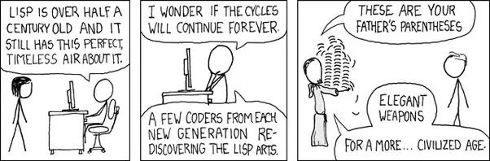
Lisp - Basics
Main data structure – Single linked list
Function call – (func arg1 arg2 arg3 …)
(defun factorial (N)
"Compute the factorial of N."
(if (= N 1) 1 (* N (factorial (- N 1)))))
Lisp Cycles, xkcd #297
Notes:
http://landoflisp.com/webserver.lisp – Example of Lisp code

Slide 10
Statistical Computation
S – Statistical Computing System
  Primary developer, John Chambers, Bell Labs (1975)
  Initially used Fortran subroutines or subroutine packages, for graphics etc.
  Vs 2 ported to Unix
  Vs 3 - By 1988-1992 coded into C and made into a functional, object-based language
Goals
  Emphasis on an interactive environment, but with programming capabilities
  Use packages for statistics, modeling and graphics

Slide 11
Big Picture of R
History of R
  Ross Ihaka and Robert Gentleman (1992)
  Implementation of S with inspiration from Scheme
  Chimera - Imperative language with a functional language
Functional Programming (Clean Functions)
  Functions take arguments, return values and have no side effects.
  Functions can be treated like a data type
  Data flows through a process of functions
  Program flow and data definitions clear from static code
Imperative Programming (Dirty Functions)
  Change global states and perform IO
  Data is mutable and can break reproducibility
Issues
  Everything in R is a function call
  R may appear slow if vector functions are improperly used
  Recursion not very efficient in R
Notes:
R – Implementation of S programming language with lexical scoping semantic inspired by Scheme, Ross Ihaka and Robert Gentleman, 1992.
R uses libraries to implement a wide variety of statistical and graphical techniques.
Lexical scoping rules allows R to be extended with more ease.
https://www.r-bloggers.com/functional-programming-in-r/

Slide 12
Syntax of R
Every statement in R is a function call
  func (arg1, arg2, arg3, …)
Comments (Start with #)
Assignment statement ( <- )
  a <- 4 + 5 or a = 4 + 5 (= only at top level)
  assign( “a”, 4 + 5)
  ‘=‘ not allowed in control structures like ‘if (a=b)’
  ‘<-’(a, ‘+’(4, 5)) # Does the same thing
Strings (“string” preferred, ‘string’ acceptable)
  Backslash handles special characters (\”)
Notes:
Make sure there are spaces on each side of ‘<-’. This avoids ambiguity with less than operator on a negative number “a < -3”

Slide 13
Making and Accessing Lists
Result
a
“1” “2” “bug” “TRUE”
b
[1] 1 2 3 4 5 6 7 8
d
[,1] [,2] [,3] [,4] [,5]
[1,] 1 5 9 13 17
[2,] 2 6 10 14 18
[3,] 3 7 11 15 19
[4,] 4 8 12 16 20
a[3]
[1] “bug”
d[3,4]
[1] 15
d[3,]
[1] 3 7 11 15 19
d[,3]
[1] 9 10 11 12
Command
# Assign a list
a <- c(1 , 2, “bug”, TRUE)
a
b <- c(1:8)
b
d <- array( 1:20, dim=c(4,5))
d
a[3]
d[3,4]
d[3,]
d[,3]
Text is Case Sensitive

Slide 14
What would the following do?
a <- c(1:5)/2
  0.5 1.0 1.5 2.0 2.5
b <- a + 4
  4.5 5.0 5.5 6.0 6.5
a+b
  5 6 7 8 9
a%*%b
  43.75

Slide 15
More Tasks
if( a<b ) {
a <- c
c <- d
} else {
c <- a
d <- c
}
Conditionals
  if(), else
Loops
  for()
  while()
  break
for( j in 1:length( a ) ) {
plot( x[ j ], y[ j ] )
}
while( a<b ) {
a <- a+1
}

Slide 16
Importing Data
Comma Separated Values
  a <- data.frame( read.csv(“filename”))
White space separated values with a header
  a <- read.table( “filename”, header=TRUE)
Access data from data frame
  a$freq
Expose data frame variables
  attach( a )
  freq
  detach( a )

Slide 17
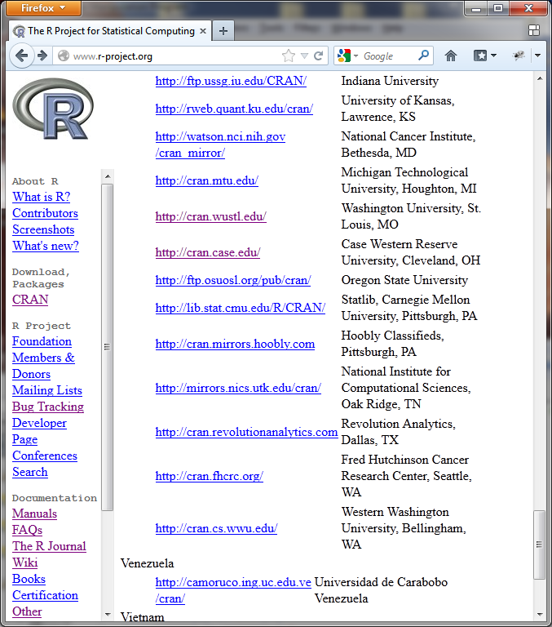
Downloading R
Where
  http://r-project.org
  CRAN (Chose download site)
  Linux, MacOS X, Windows
Notes:
Wikipedia – Birthday picture

Slide 18
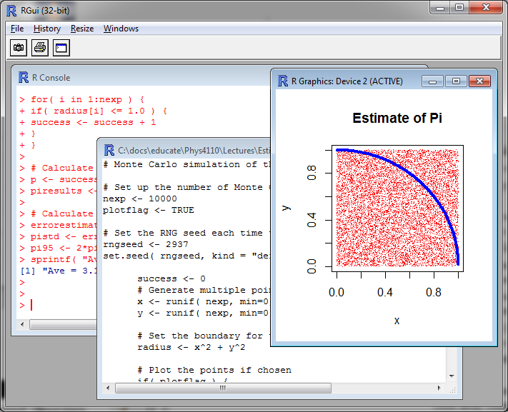
R Gui
Console
Script
Graphics
Help (R Manuals)

Slide 19
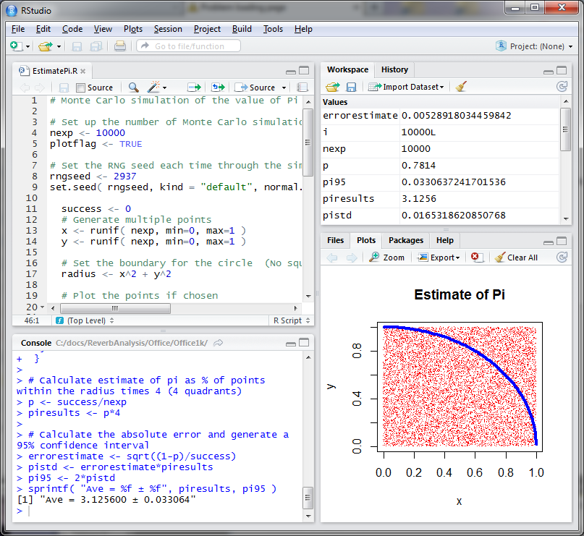
RStudio
Script
Workspace
Console
Files/Help
R can be run through an online server using RStudio and other corporate software.
https://www.rstudio.com

Slide 20
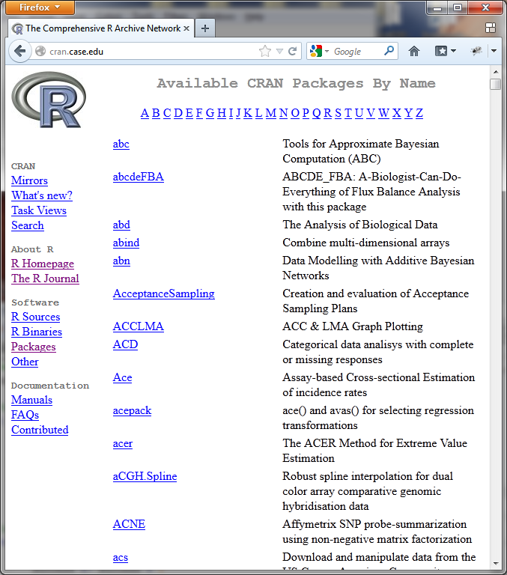
Packages
11,533 packages available through CRAN
Related Projects
  https://www.r-project.org/other-projects.html
  Bioinformatics w/ R
  Spatial Statistics w/ R

Slide 21
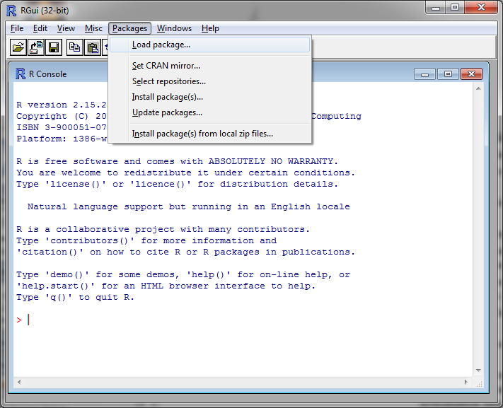
Installing
Packages
Packages
  Download *.zip files
  Install packages (local/CRAN)
R is updated annually.
Packages should be updated at the same time.

Slide 22
Graphics in R
Lattice Graphics (Default)
ggplot2
  Hadley Wickham (2005)
  Use Grammar of Graphics (Wilkinson, 2005)
  Break graph into semantic components
  Ex. Layers, stats, geometries, aesthetics, facets, …
See - http://www.r-graph-gallery.com/
Notes:
Wickham is a developer at Rstudio

Slide 23
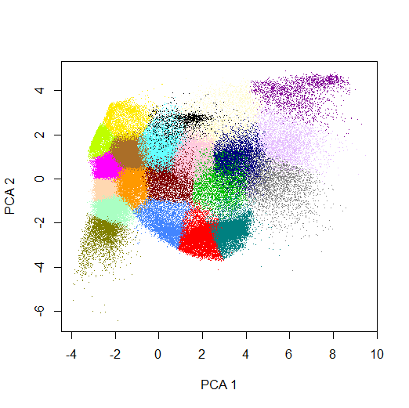
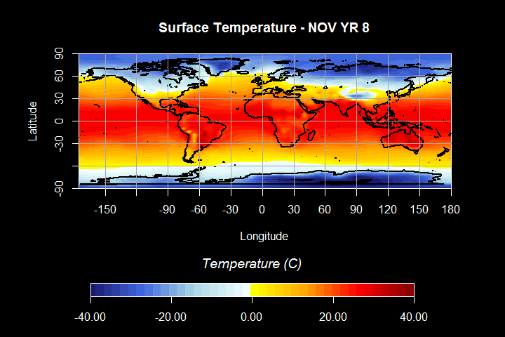
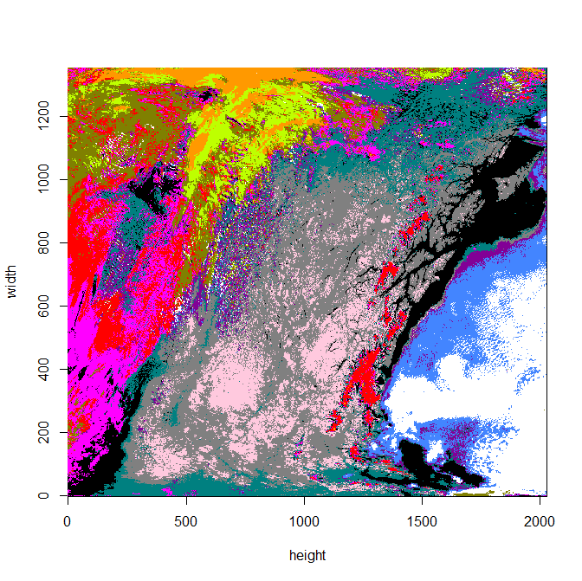
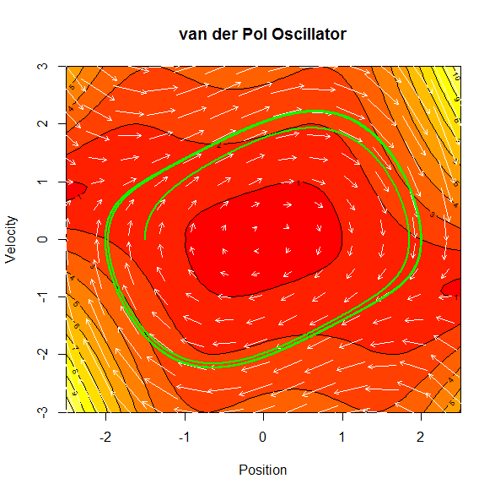
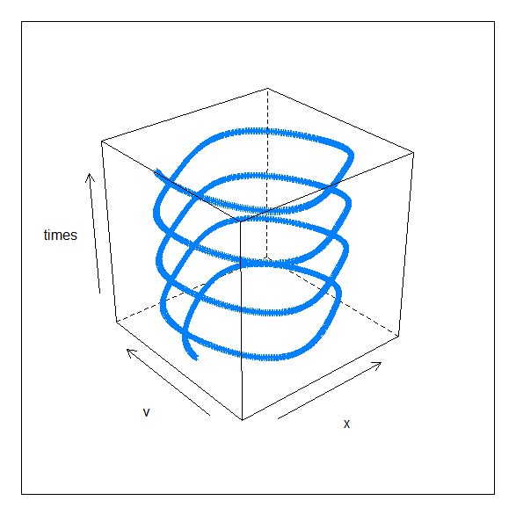
Graphing Examples

Slide 24
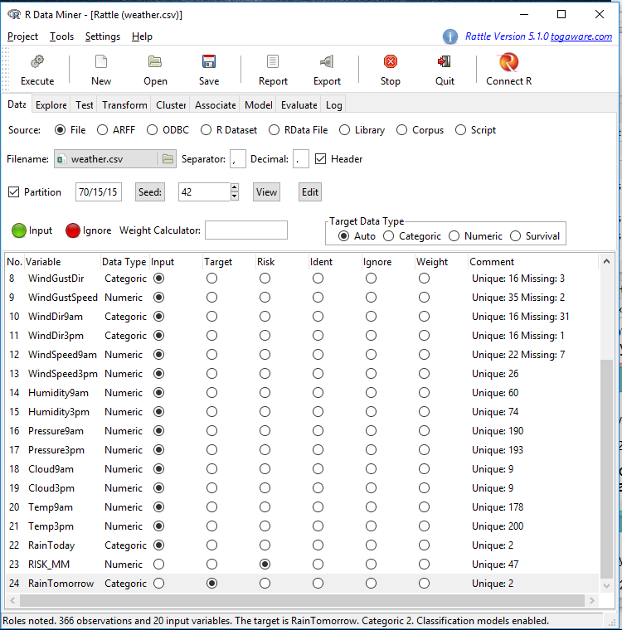
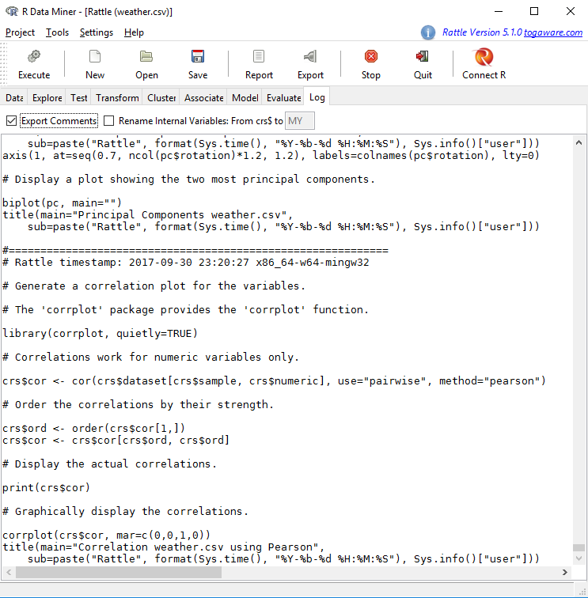
Rattle
> install.packages(“rattle”,
+ repos=‘http://iis.stat.wright.edu/CRAN/’)
> library( “rattle” )
> rattle()

Slide 25
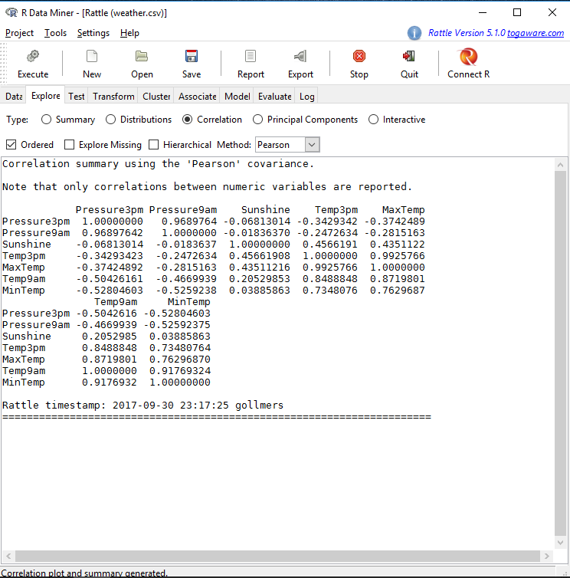
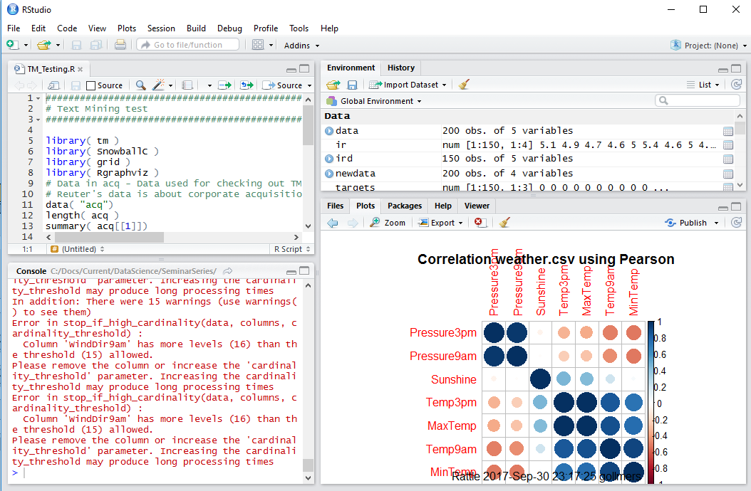
Rattle Cont.

Slide 26
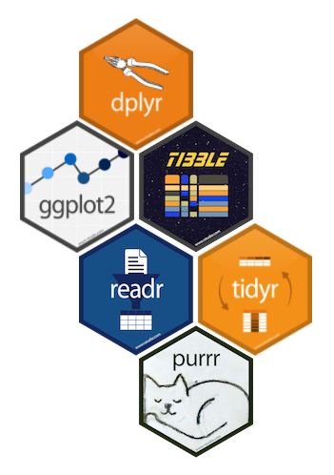
R and Data Science
Tidyverse – Collection of R packages sharing an underlying philosophy and common APIs.
  dplyr – grammar of data manipulation
  ggplot2 – grammar of graphics
  tibble – reimagining data.table
  readr – read rectangular data
  tidyr – standard data storage
  purrr – enhanced functional programming

Slide 27


Additional Capabilities
knitr
  Successor to SWEAVE
  Dynamic reports using literate programming
  Can generate reports using LaTex, Lyx, Html, Markdown, …
  https://yihui.name/knitr/
Shiny
  Build dashboards for web interface.
  http://shiny.rstudio.com/gallery/

Slide 28
Resources
An Introduction to R
  http://cran.r-project.org/doc/manuals/r-release/R-intro.html
R FAQ
  http://cran.r-project.org/bin/windows/base/rw-FAQ.html
Other Documentation
  http://www.r-project.org/other-docs.html
The R Journal
  http://journal.r-project.org/current.html
R Wiki
  http://rwiki.sciviews.org/doku.php
R Bloggers
  https://www.r-bloggers.com/
R Gallery
  http://gallery.r-enthusiasts.com/

