Slide 1
Graphics With R
Data Science Seminar
November 19, 2018
Steve Gollmer

Slide 2



What is R?
S
Lisp – LISt Processor
  McCarthy (1958, MIT)
  Use recursive functions of symbolic expressions
Lambda Papers
  Development of Scheme (1975-80, MIT)
  Treat computation like evaluating mathematical functions
S
  Chambers (1975, Bell Labs)
  Interactive environment for statistical computing
R
  Ihaka and Gentleman (1992, U of Auckland, NZ)
  Scheme inspired implementation of S
Notes:
Lambda papers describe

Slide 3
Basic R syntax
# Calculate Factorials to 10
for( j in 1:10) {
n <- j
val <- 1
while( n > 1) {
val <- val*n
n <- n - 1
}
print( paste(j, "! = ", val, sep="" ))
}
“1! = 1”
“2! = 2”
“3! = 6”
“4! = 24”
“5! = 120”
Every statement in R is a function call
  Func( arg1, arg2, arg3, …)
Comments start with #
Assignment statements use “<-” rather than “=“
Preferred designation for strings is “string”, but ‘string’ is acceptable
Conditionals
  if(), else
Loops
  For(), while(), break

Slide 4
Making and Accessing Lists
a
“1” “2” “bug” “TRUE”
b
[1] 1 2 3 4 5 6 7 8
d
[,1] [,2] [,3] [,4] [,5]
[1,] 1 5 9 13 17
[2,] 2 6 10 14 18
[3,] 3 7 11 15 19
[4,] 4 8 12 16 20
a[3]
[1] “bug”
d[3,4]
[1] 15
d[3,]
[1] 3 7 11 15 19
d[,3]
[1] 9 10 11 12
Command
# Assign a list
a <- c(1 , 2, “bug”, TRUE)
a
b <- c(1:8)
b
d <- array( 1:20, dim=c(4,5))
d
a[3]
d[3,4]
d[3,]
d[,3]

Slide 5
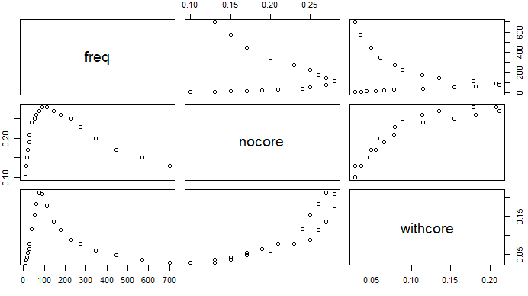
Data Frames
Dataframes are tables of labeled factors
Import data from CSV file
  a <- data.frame( read.csv(“lrc.csv”) )
Plot the data
  Plot( a )

Slide 6
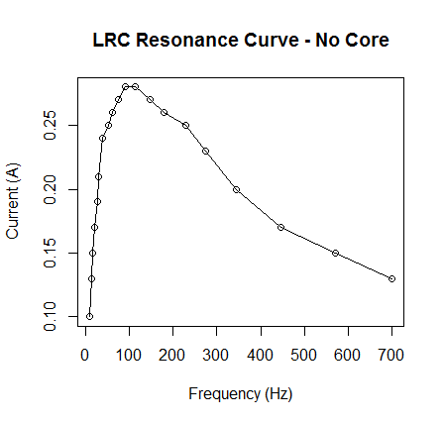
Basics Graphics in R – Line Plot
# Demonstrate visual features of R graphics
a <- data.frame( read.csv("lrc.csv"))
attach( a )
plot( freq,
nocore,
xlab="Frequency (Hz)",
ylab="Current (A)" )
lines( freq, nocore)
title( "LRC Resonance Curve - No Core" )
detach( a )

Slide 7
par() – Query or Set Graphical Parameters
Common Parameters
  bg – Background color
  fg – Foreground color
  lwd – Line width
  lty – Line type
  col – Color of item
  cex – Magnify text and plotting symbols
  pch – Symbol or letter used for plotting data
  log – Plot axis on logarithmic scale
Making changes
  Use parameters within plot() for one use
  Use par( bg = “black” ) for multiple uses
par( bg="gray22" )
par( fg="yellow" )
par( col.axis ="white")
par( col.lab ="white")
par( col.main ="white")
par( cex = 1.2 )
par( family="serif")

Slide 8
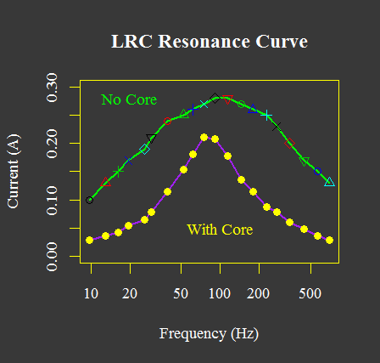
plot( freq,
nocore,
xlab="Frequency (Hz)",
ylab="Current (A)",
ylim=c( 0, 0.30 ),
log = "x",
col="green",
lwd=2,
type="l")
points( freq, nocore, col=c(1:5), pch=c(1:6))
lines( freq, withcore, lwd=2, col="purple" )
points( freq, withcore, pch=19, col="yellow" )
title( "LRC Resonance Curve" )
text( 100, 0.05, "With Core", col="yellow")
text( 20, 0.28, "No Core", col="green")

Slide 9
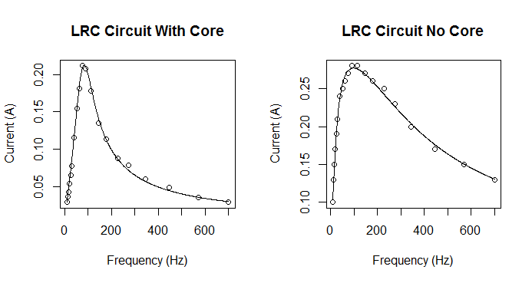
Using multiple divisions on the canvas
#Split screen into two regions
split.screen( c(1,2) )
#Plot the original data
screen( 1 )
plot( freq, withcore, xlab = 'Frequency (Hz)', ylab = 'Current (A)', main = 'LRC Circuit With Core')
#Plot the fitting curve
modfit <- lrccurveA( q )
lines( freqA, modfit )
#Plot the original data
screen( 2 )
plot( freq, nocore, xlab = 'Frequency (Hz)', ylab = 'Current (A)', main = 'LRC Circuit No Core')
#Plot the fitting curve
modfit <- lrccurveA( p )
lines( freqA, modfit )
#Close the split screen
close.screen(all = TRUE)
Split the screen into regions
  Split.screen( c(1,2) ) – 1 Row, 2 Columns
Example from ‘lrc.R’
  Non-linear curve fit applied to data

Slide 10
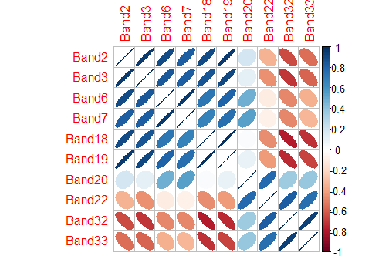
Other Plots – Correlation Plot
From 10BandAnalysisNew.R
# Correlation Plot
library( corr )
# Generate a correlation matrix from the satellite spectral bands
datacor <- cor( satdata, use="complete.obs")
# Visualize the correlation matrix using corrplot
corrplot( datacor, method="ellipse" )

Slide 11
Saving graphics as PDF or bitmap
From MovieFrameDataField.R
Process
  Open a new device with a specified resolution.
  Generate plot
  Save results of the device to an output file (PDF, PNG, …)
# Set up the graphics device so it matches the PNG image
dev.new( width=imagewidth, height=imageheight, res=imageres )
# Plot data
plotdatamap( ptitle, keylabel, ncMatrix, range, autoscale )
# Save the image in a png format
dev.print( png, file=outfilename, width=imagewidth, height=imageheight, units="in", res=imageres)

Slide 12
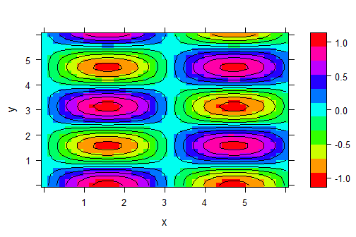
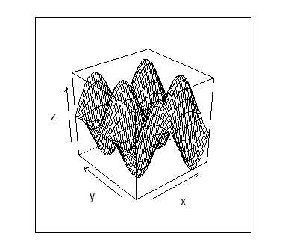
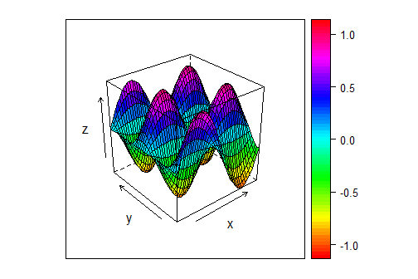
3D Plots
Different projections
# 3D Plot Examples
library( lattice )
x <- seq(0, 6, by=0.15)
y <- seq(0, 6, by=0.15)
grid <- expand.grid(x=x, y=x)
for( i in 1:(length(x)*length(y))) {
grid$z[i] <- sin(grid$x[i])*cos(2*grid$y[i])
}
levelplot(z~x*y, grid, contour=TRUE, regions=TRUE, col.regions=rainbow(100), cuts=10)
wireframe( z~x*y, grid)
wireframe(z~x*y, grid, drape=TRUE, col.regions=rainbow(100))
Use Lattice Graphics
Place data on a regular grid
Plot functions
  levelplot() – Contour plot
  wireframe() – 3d surface

Slide 13
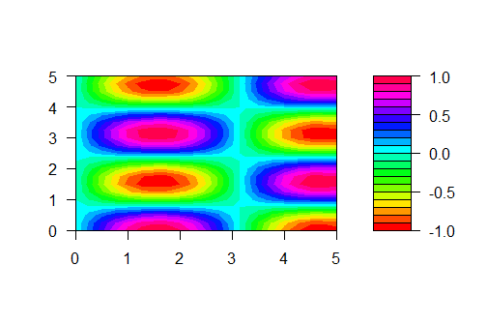
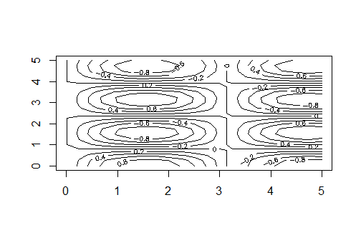
3D Plots - Contour
Without Lattice graphics, use the Contour function
# 3D Plot Examples with contour
x <- seq(0, 5, by=0.25)
y <- seq(0, 5, by=0.25)
z <- matrix( 1:(length(x)*length(y)), length(x), length(y))
for( i in 1:length(x) ) {
for( j in 1:length(y) ) {
z[i,j] <- sin(x[i])*cos(2*y[j])
}
}
filled.contour( x, y, z, col=rainbow(20) )
contour( x, y, z)

Slide 14
Customized Filled Contours
keylessfilled.contour <-
function (x = seq(0, 1, len = nrow(z)),
y = seq(0, 1, len = ncol(z)),
z,
xlim = range(x, finite=TRUE),
ylim = range(y, finite=TRUE),
zlim = range(z, finite=TRUE),
levels = pretty(zlim, nlevels), nlevels = 20,
color.palette = cm.colors,
col = color.palette(length(levels) - 1),
plot.title, plot.axes, key.title, key.axes,
asp = NA, xaxs="i", yaxs="i", las = 1, axes = TRUE,
frame.plot = axes, ...)
{
if (missing(z)) {
if (!missing(x)) {
if (is.list(x)) {
z <- x$z
y <- x$y
x <- x$x
}
else {
z <- x
x <- seq(0, 1, len = nrow(z))
}
}
else stop("no 'z' matrix specified")
}
else if (is.list(x)) {
y <- x$y
x <- x$x
}
if (any(diff(x) <= 0) || any(diff(y) <= 0))
stop("increasing 'x' and 'y' values expected")
## Plot the 'plot key' (scale):
# plot.new()
## Plot contour-image::
plot.new()
plot.window(xlim, ylim, "", xaxs=xaxs, yaxs=yaxs, asp=asp)
if (!is.matrix(z) || nrow(z) <= 1 || ncol(z) <= 1)
stop("no proper 'z' matrix specified")
if (!is.double(z))
storage.mode(z) <- "double"
.filled.contour(as.double(x),
as.double(y),
z,
as.double(levels),
col = col)
if (missing(plot.axes)) {
if (axes) {
title(main="", xlab="", ylab="")
Axis(x, side=1)
Axis(y, side=2)
}
}
else plot.axes
if (frame.plot) box()
if (missing(plot.title))
title(...)
else
plot.title
invisible()
}
filled.contour() always includes a color key
  Code for filled.contour() is written in R and can be inspected.
  Copied the code and removed the portion generating the key.
  Renamed the function keylessfilled.contour()
View function code by typing the function name
  filled.contour

Slide 15
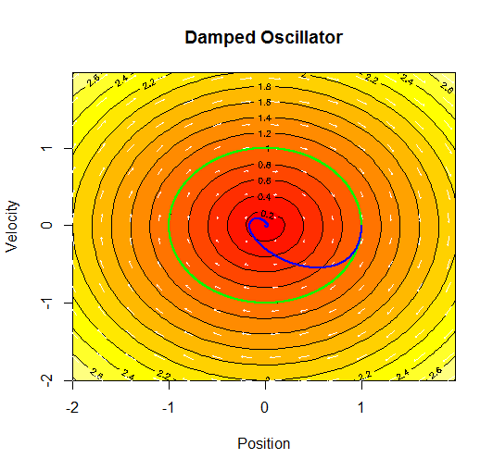
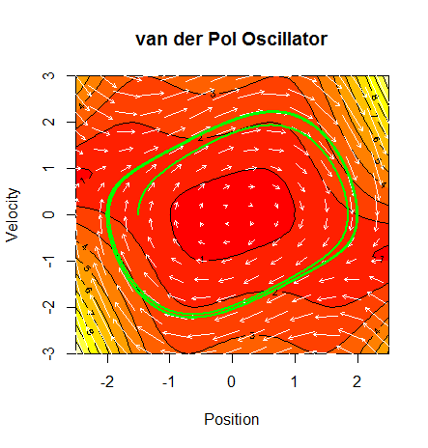
Phase Diagrams
From DampedOscillator.R
Set up differential equation describing motion
Call DirectionField() to make a phase plot
  Call keylessfilled.contour()
  Overlay with contours()
  Add arrows for direction
Examples
  Damped Oscillator
  van der Pol Oscillator

Slide 16
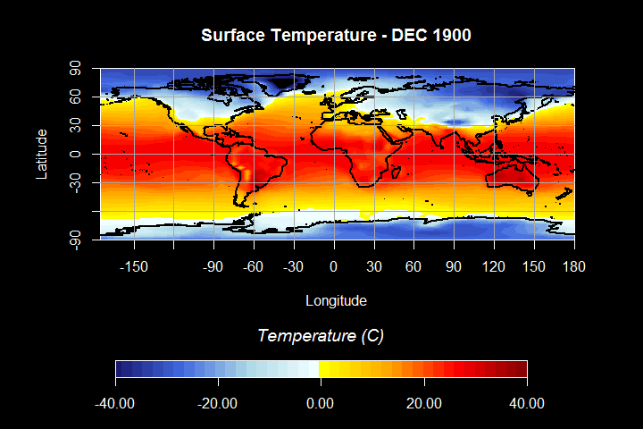
Geographic plots
library( maps )
# Set up the axis
x <- 5*(1:72)-180
y <- 4*(0:45)-90
x.at <- seq(-180, 180, by=30 )
y.at <- seq(-90, 90, by=30 )
axis(1, at=x.at)
axis(2, at=y.at)
box()
title(main=title, font.main=2)
keylessfilled.contour( palettedata, nlevels=numcontours, color=panoplypalette, axes=FALSE)
# Add continent outlines
map( add=TRUE, interior=FALSE, fill=FALSE, lwd=2 )
From MovieFrameDataField.R
  Add library( maps )
  Use keylessfilled.contour()
  Set up plotting area
  Plot the data
  Add continental outlines
  Add latitude, longitude lines

Slide 17
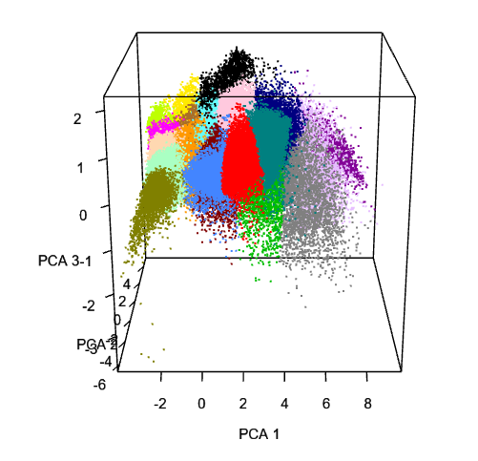
Web generated 3d plot
library( R2HTML )
library( rgl )
open3d()
par3d( windowRect= c(5, 5, 612, 612 ) )
Sys.sleep( 0.1 )
plot3d( cleansub[,1], cleansub[,2], cleansub[,3], col=clusters$cluster, size="2", xlab="PCA 1", ylab="PCA 2", zlab="PCA 3" )
writeWebGL( filename = "3dPCA123New.html" )
From 10BandAnalysisNew.R
View 3dPCA123New.html in Firefox browser

Slide 18

Tidyverse
Collection of R packages sharing an underlying philosophy and common APIs.
  dplyr – grammar of data manipulation
  ggplot2 – grammar of graphics
  tibble – reimagining data.table
  readr – read rectangular data
  tidyr – standard data storage
  purrr – enhanced functional programming
To use need to install in R
  install.packages(“tidyverse”)

Slide 19
ggplot2
Developer – Hadley Wickham (2005)
Use Grammar of Graphics (Wilkinson, 2005)
Break graph into semantic components or layers
  Stats – Statistical transformations
  Geometries – Types of plots or representations of the data
  Aesthetics – Visual property like size, shape and color of points
  Facets – Set up multiple graphs
Connect layers with +
Pipe a sequence of steps on one object with %>%

Slide 20
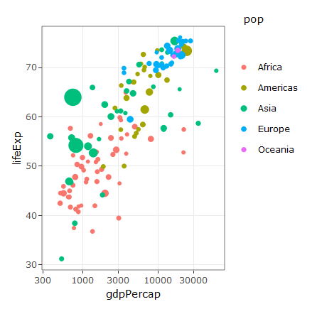
# ggplot2 Example
# https://www.r-graph-gallery.com/portfolio/ggplot2-package/
library(ggplot2)
library(plotly)
library(gapminder)
p <- gapminder %>%
filter(year==1977) %>%
ggplot( aes(gdpPercap, lifeExp, size = pop, color=continent)) +
geom_point() +
scale_x_log10() +
theme_bw()
ggplotly(p)

Slide 21
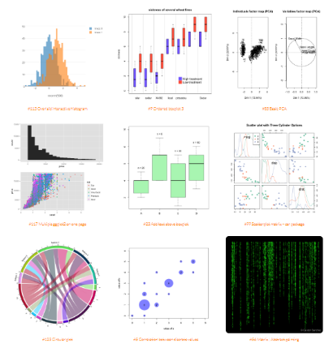
The R Graph Gallery
Examples of R Graphics
  Sample code
  Illustrate different packages
Other Resources at the site
  GGPlot2 Examples
  Python Examples
https://www.r-graph-gallery.com/

